Slide 1
Drug Dosage Modeling GUI using MATLAB
Team members:
Youssef Ashraf
Ahmed Khamis
Magdy Abdelfadeel
Shahd Hesham
Ahmed Wael

Slide 2
Objective
- Design a GUI using MATLAB for modeling drug concentration over time using multiple numerical methods.
- Compare the numerical methods to the exact analytical solution.

Slide 3
Inputs and Interface
User Inputs:
- Initial Concentration (C₀)
- Elimination Rate (k)
- Total Time (T)
- Time Step (h)
Features:
- Graph plotting
- Exporting data (CSV, PNG)
- Comparing different methods

Slide 4
Numerical Methods
- Forward Euler
- Backward Euler
- Heun's Method
- Midpoint Method
- Runge-Kutta (4th order)
- Adams-Bashforth
- Adams-Moulton

Slide 5
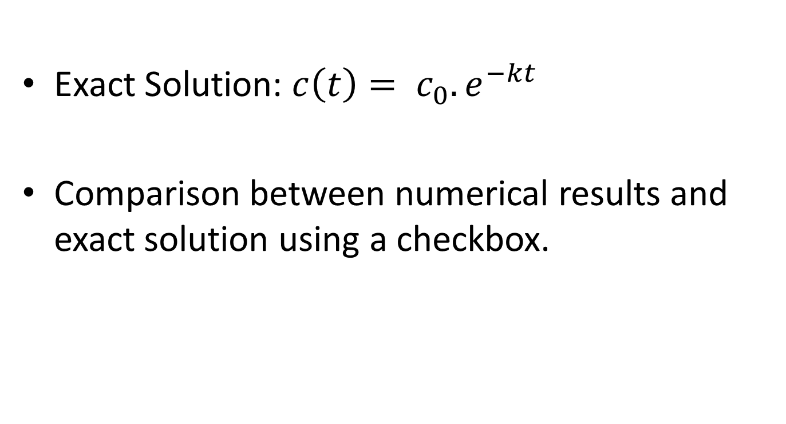
Exact vs Numerical
Exact Solution: $c\left(t\right)= c_{0}.e^{−kt}$
Comparison between numerical results and exact solution using a checkbox.

Slide 6
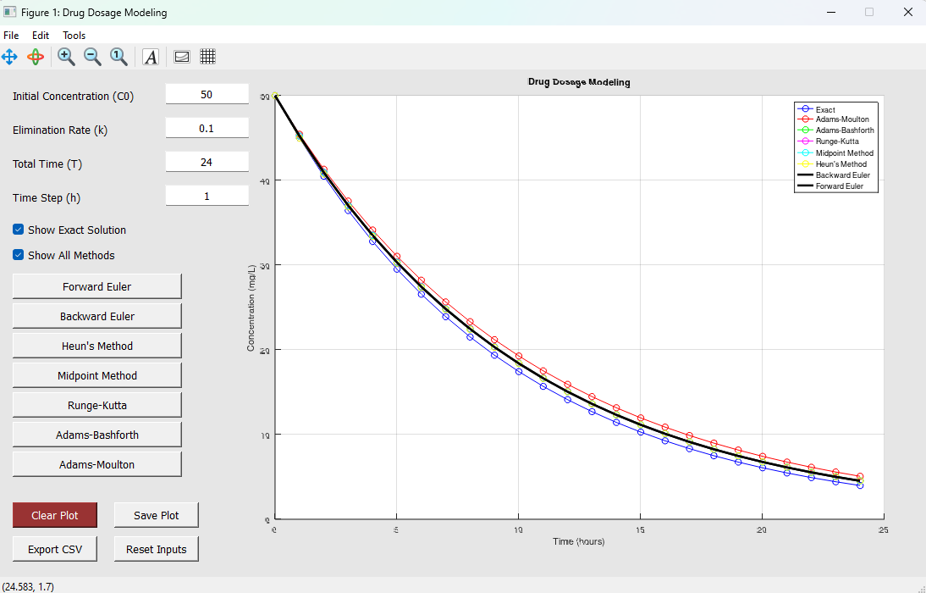
GUI Snapshot

Slide 7
Features Summary
Intuitive and user-friendly design
Dynamic plotting
Plot saving (PNG)
Data exporting (CSV)
Supports comparison of all methods with the exact solution

Slide 8
Conclusion
- An interactive tool for modeling drug concentration over time.
- Ability to compare various numerical methods to the exact solution.
- Easily expandable for more complex scenarios.

